Slide 1

NUS Classroom4U NUS Fintech Dev II Project Team 4: Moses Wu, Reginald Oh, Sim Teng Leong

Slide 2


NUS Classroom4U Service Platform
Students’ Database Table
Name
Age
Subjects Interested
Study Level (e.g. P1, P2)
Mobile number
Email address
Postal Code
Match students (clients) to our in-house tutors.

Slide 3
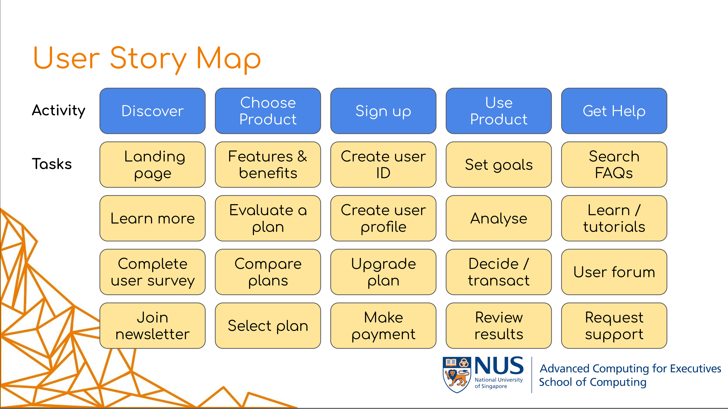
Service Platform Setup
For this Proof-of-Concept,
we will focus on the “Discovery” stage of user story.
User Process:
Students register with us.
Us respond to the enquiry (using the backend DB).
Students, for now will not be accessing their records in the frontend.
Frontend Design:
Typical sections to introduce the service.
Include a section to collect user information (data).
Backend Design:
For now, only the project team will access the backend database.
Notes:
https://github.com/jscheele/nusmoneysample

Slide 4
Demonstration

Slide 5
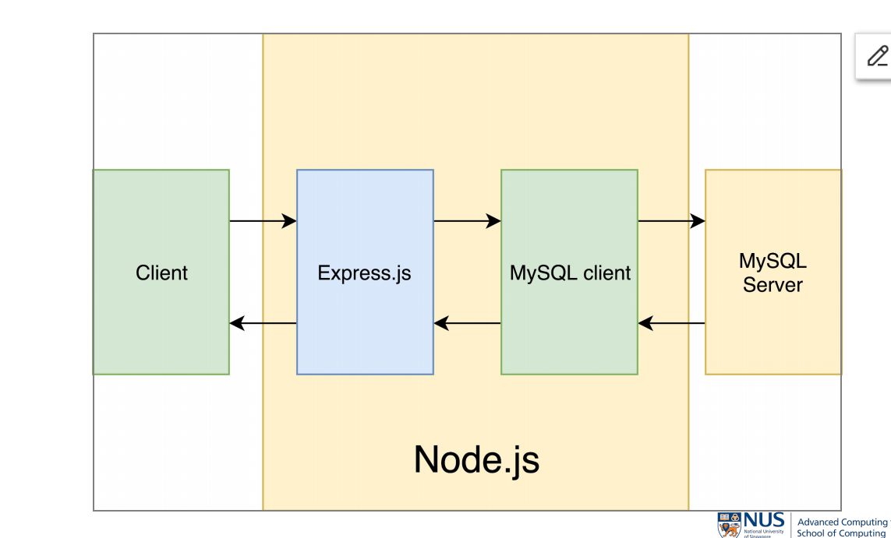
Lesson Learnt
Node.js
Client
Express.js
MySQL
client
MySQL
server
GitHub
Repo
We were able to partially fulfill these areas…
What went well? | What we had trouble? | What would we do differently? | How can we build on this?
Better appreciation for the effort in frontend / backend development. Team members’ willingness to experiment and actively participate. | Lack of skillset and practical experience of frontend / backend development. | Seek out reference materials online. Seek advice from classmates / colleagues. | Leverage these knowledge / skills when opportunities opportunity arise. Use the foundation to better manage such projects in our profession.

Slide 6
Thank You.

Slide 7
Frontend HTML
e.g. Financial HTML example
YAML
e.g. financial planning
(Documentation, not code)
Node JS
App.js
DB

